Slide 1
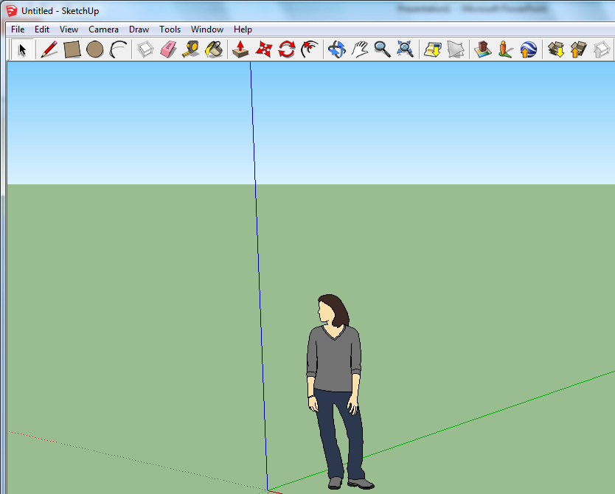
Using Sketch up-getting use to the tools
Rectangle
Push/Pull tool
Line tool
Orbit tool
0
0
0
0
Task 1: In one lesson, how often do you use the arrowed tools, put a number in the boxes to the left.
If you could teach someone else who did not know anything about Sketch up, how long would it take you to teach them? (put an X in the box)
1 hour
2 hours
Longer

Slide 2
Print screen your apartment design
Print screen Top view
Identify Positive Feature of the design:
Identify possible improvements:
Print screen Side view
Give an example of one tool you have used for this task.:

Slide 3
Print screen your school design
Print screen Top view
Identify Positive Feature of the design:
Identify possible improvements:
Print screen Side view
Give an example of one tool you have used for this task.:

